Slide 1
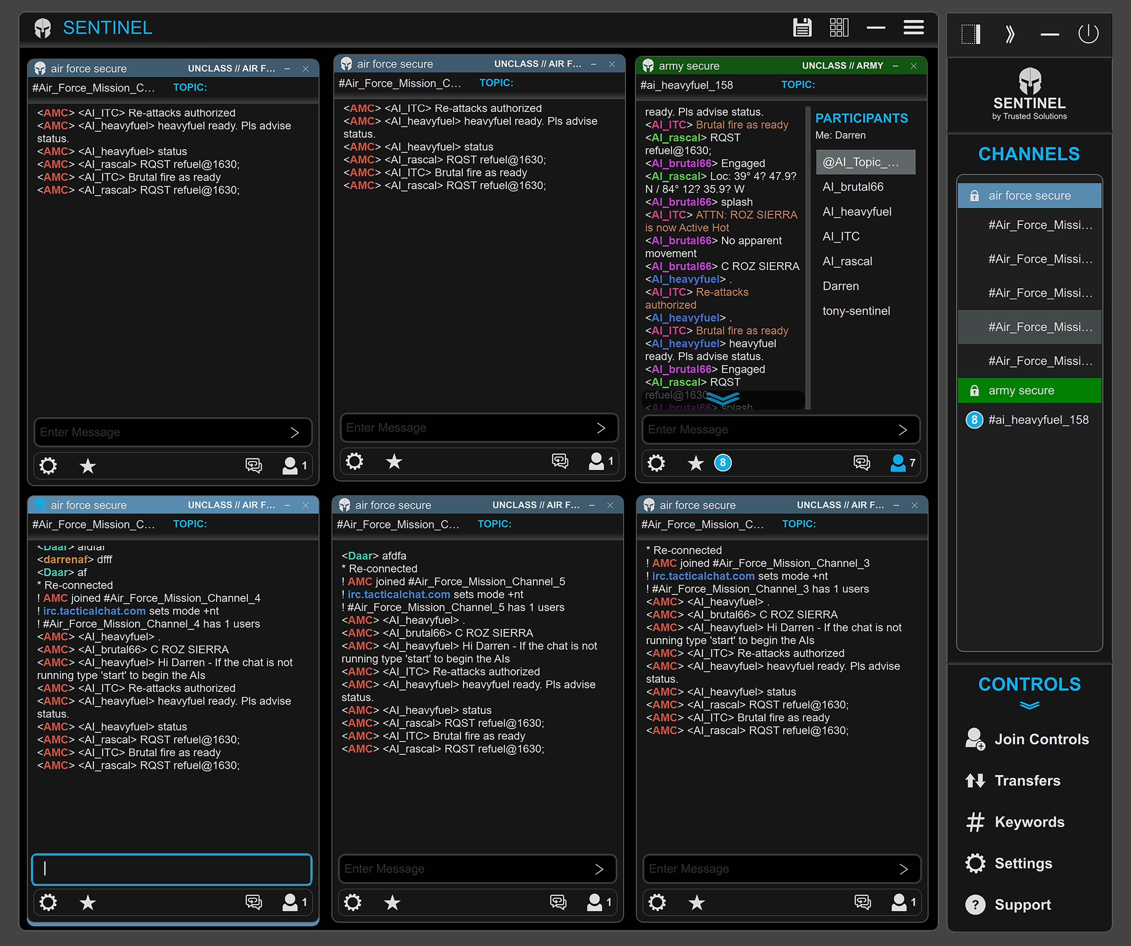
SENTINEL SECURE CHAT CLIENT
(Simulated Mission Layout)

Slide 2
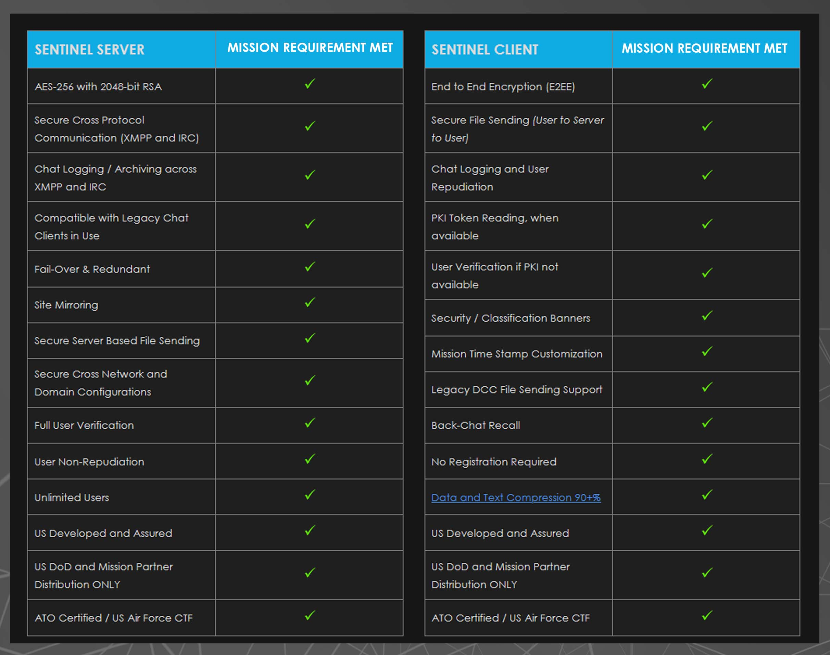
LIST OF MISSION REQUIRED CAPABILITIES
(Mission Derived Features and Capabilities)

Slide 3
KEY MISSION INTEROPERABILITY FEATURES
LEGACY SERVER AND CHAT CLIENT SUPPORT
The SENTINEL Server is compatible with all known existing US and Partner Nation mission utilized chat client applications, including, but not limited to, mIRC, Pidgin, hexChat, TransVerse and MAKO.
The SENTINEL Client is compatible with all known operating chat servers in the US DoD community including, but not limited to, Bahamut, OpenFire, and MAKO servers.
CROSS IRC and XMPP PROTOCOL COMMUNICATIONS
The SENTINEL Gateway feature bridges IRC and XMPP users together in a single, collaborative mission chat environment via an integrated protocol gateway feature.
This integrated solution allows for combined, cross-community and cross network chat, in controlled and secured chat channels, compartmentalized by classification needs and fully controlled and configured by system Administrators.
LEGACY DCC FILE SENDING SUPPORTED
Direct Client to Client (DCC) file sending is supported, with compatible clients, and as allowed by a chat network’s policy.

Slide 4
KEY MISSION SECURITY FEATURES
END TO END ENCRYPTION (E2EE)
SENTINEL Chat Client provides encryption for sending of files and messages.
SECURE FILE SENDING
The SENTINEL Chat Client can send files securely and be stored for recipients on the SENTINEL Chat Server.
Recipients are alerted to files sent and Senders are provided a receipt of file acceptance.
Files are deleted from the file server at an Administrator specified time interval.
CLASSIFICATION AND GROUP BANNERS
SENTINEL provides classification banners and colors, set by site admins, and allows users to quickly identify different server classifications, groups, or domains.
USER NON-REPUDIATION
SENTINEL extends its Non-repudiation capability by capturing all user and user system information, including mac addresses, IP addresses, domain credentials, and SIPR token logging, when available.

Slide 5
KEY RELIABILITY FEATURES
BANDWIDTH SAVINGS & DATA HANDLING
SENTINEL Server-to-Client compression decreases data traffic by 90% or more.
This is required by high latency / low bandwidth / tactical edge users
minimizes and/or prevents disconnection frustrations suffered by tactical edge sites and users.
NETWORK DESIGN, FAIL-OVER & REDUNDANCY PLANNING
SENTINEL is engineered to seamlessly merge two or more geographically separated/online and available server access points or dedicated server/fully mirrored backups, mitigating local site failure impacts on the rest of the chat network.
DEVELOPED, TESTED, AND PROVEN IN MISSION ENVIRONMENTS
The SENTINEL Secure Chat solution’s development is based on Trusted Solutions’ decade of continuous improvements to meet forward operating combat and C2 mission requirements.
Keeping development focused on mission-oriented capability, while making sure ongoing maintenance and improvements are kept current.
Current Trusted Solutions Servers have operated for AFCENT with a 99.9% uptime for over a decade, while serving up over 300 million mission messages annually at a single location.

Slide 6
KEY TRANSITION CONCEPTS
CERTIFICATE TO FIELD and LOCAL WAIVERS
Receive Certificate to Field (CTF) designation from appropriate agency and/or gain Commander’s local waivers for a System Testing Phase.
SYSTEM TESTING
Create a closed or fenced network for initial installation, and to provide for local testing, scanning, ratings, supervisor training and demonstrations.
SERVER CHANGE OVER FROM EXISTING CHAT SERVER(S)
SENTINEL Server Change Over will require an Authorized Service Interruption (ASI) from the Command.
The change over activity and the chat network outage period will be 5 minutes or less. Once the SENTINEL chat server is operational , the connections and the chat communication can continue as before. The server switch over will be virtually transparent to mission operators.
CLIENT CHANGE OVER
SENTINEL distribution by local network administrators should occur, along with notices to operators from the admin on the availability of SENTINEL, links to information about the new client, and information on training resources.

